Slide 1
MODERN DATA ARCHITECTURES
Group 5
Alejandro Sancho
Jimena Germana
Sebastian Piscoya
Prashant Soi

Slide 2
AGENDA
1. Business case
2. Data pipeline
3. Data sources
4. Data Storage
5. Data Processing
6. Business Questions

Slide 3

Business case
The goal is to create a machine learning model to predict if a person would get a loan or not, therefore it is a classification problem.
While applying for Loan is exhausting process for the applicant as well as Bank. It costs bank a lot of time and efficiency. Hence, automating the loan eligibility process (real time) based on customer information.

Slide 4



DATA PIPELINE
DATA SOURCES
DATA STORAGE
DATA PROCESSING

Slide 5
DATA SOURCES
The dataset was obtained from Kaggle: kaggle.com/datasets/altruistdelhite04/loan-prediction-problem-dataset
Dataset columns:
Loan ID
Gender
Married
Dependents
Education
Self_Employed
Applicant Income
Co Applicant income
Loan Amount
Loan_Amount_Term
Credit_History
Property_Area
Loan_Status
There are altogether 13 columns in our data set. Of them Loan_Status is the response variable and rest all are the variables/factors that decide the approval of the loan or not.

Slide 6
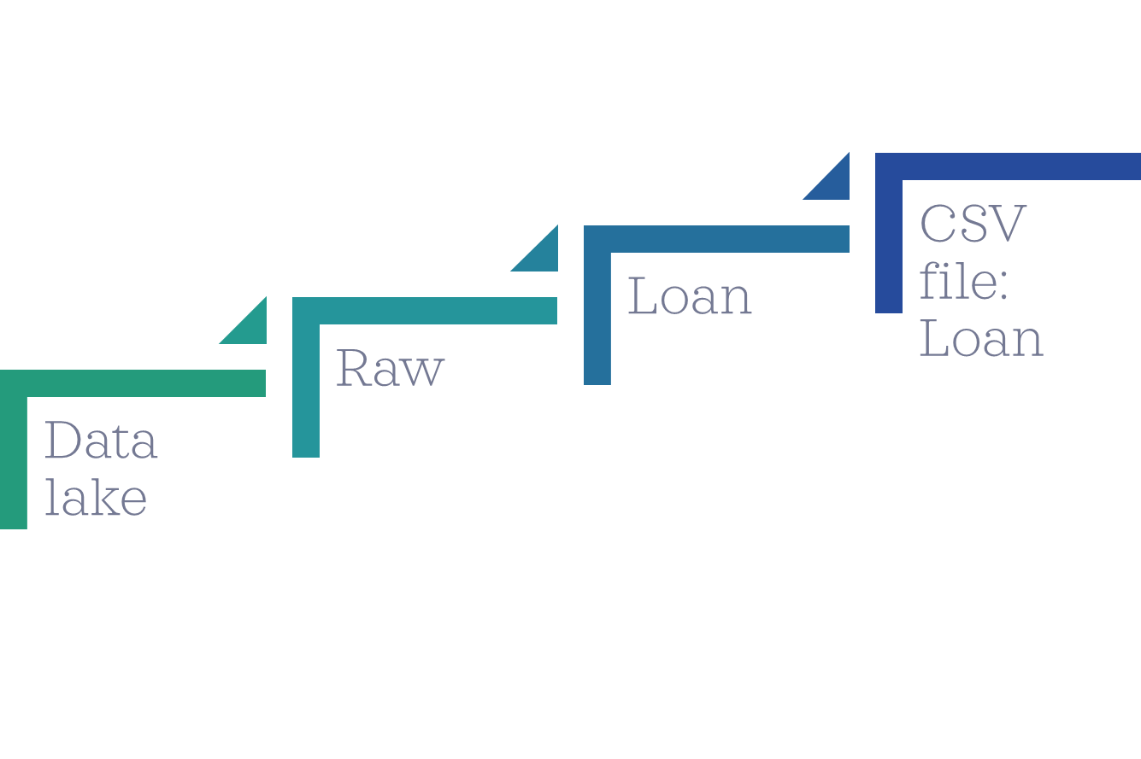
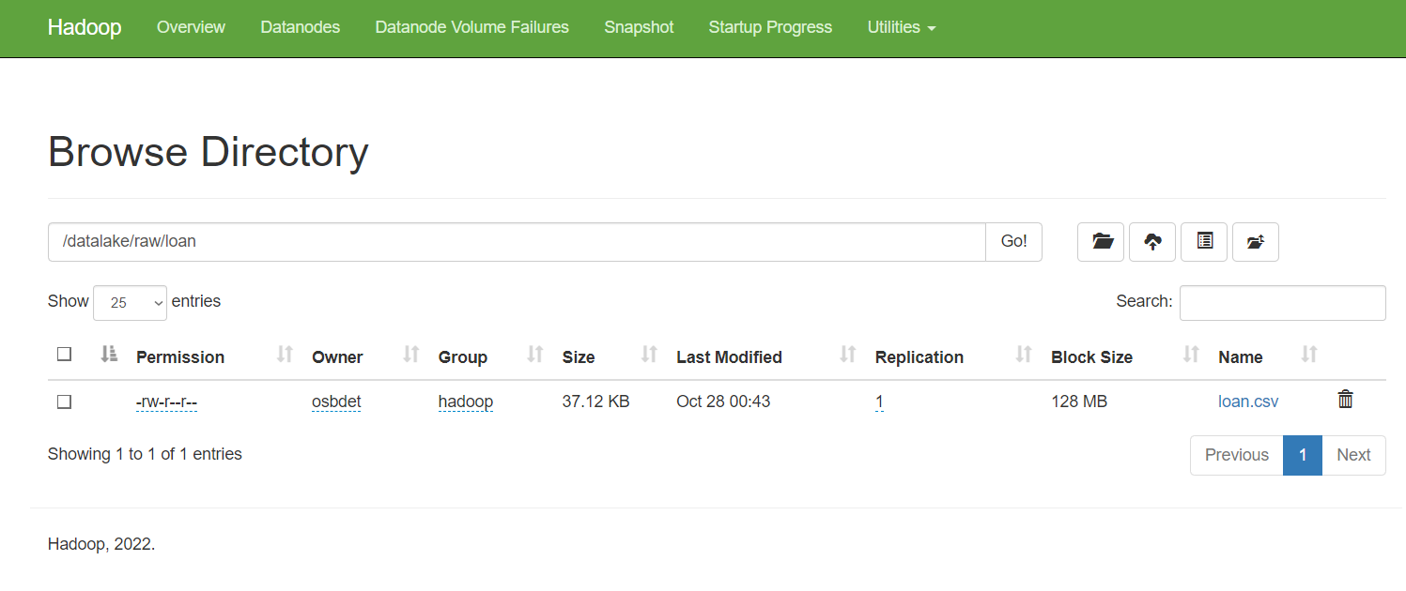
DATA STORAGE
We created a structure in our data lake for storing the files by using Hadoop HDFS.
This will give us a file path for so we can call and process the data using Spark.

Slide 7

DATA PROCESSING
Data preparation
Model evaluation
Model persistence
1
3
5
2
4
6
Model training
Model loading
Model selection

Slide 8

DATA PREPARATION
It consisted of the following steps:
Data Cleaning
Checking For Null Values
For the Categorical Columns filling the Nulls with higher Frequency of the occurrence
Checked for the outliers in Numerical Columns
The Null in Numerical columns such as Loan Amount and Loan Term were filled with imputer function using strategy as Median and Mode respectively.
Feature Engineering
Changing the target column in Boolean
Transforming columns Applicant income and Co-Applicant Income as Total Income
Performed One Hot encoding on categorical Columns

Slide 9

MODEL TRAINING
Here is the list of few classification algorithms from Spark ML we tried :
Logistic Regression
Decision Tree Classifier
Random Forest Classifier
Gradient-boosted tree classifier
Naive Bayes
Linear Support Vector Machine

Slide 10
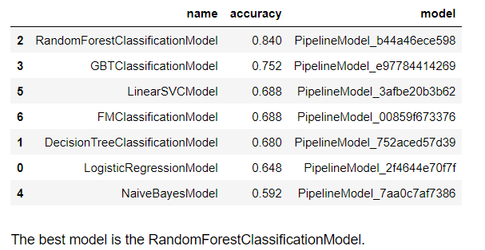
MODEL EVALUATION & SELECTION

Slide 11
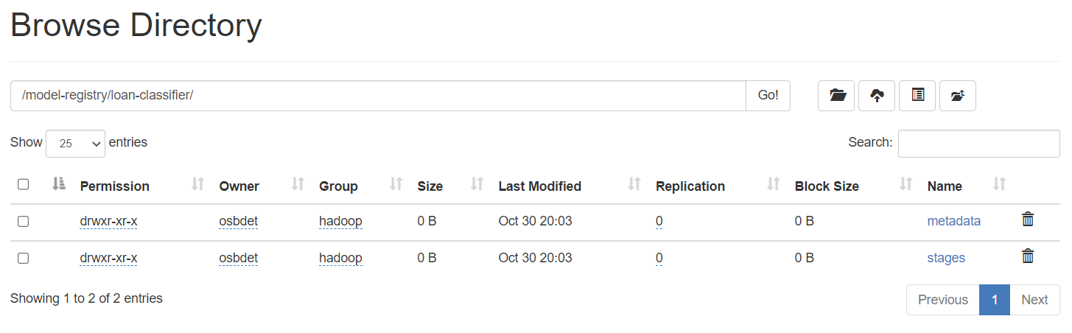
MODEL PERSISTENCE & LOADING
Random Forest Classification was the best model for our case and we uploaded the pipeline in HDFS to make the predictions on the new data.
Check directory contents:
http://localhost:50070/explorer.html#/model-registry/loan-classifier/

Slide 12
BUSINESS QUESTIONS

Slide 13


Q1. Does Education play a distinguishing role in getting the approval as per our assumption?
Q2. How does Marriage impacts the Loan Approval?
People with higher education get more than 300% loan approvals
Married people get 155% more loan approvals

Slide 14
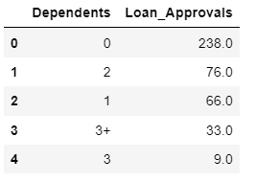
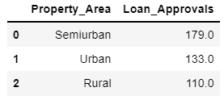
Q4. Which applicant's property type is more likely to get a loan approved?
Q3. What's the optimal number of dependents to get a loan approved?
Applicants living in Semi Urban property are more likely to get the loan (30% more compared to the average)
The lower the number of dependents, the higher the loan Approval Status

Slide 15
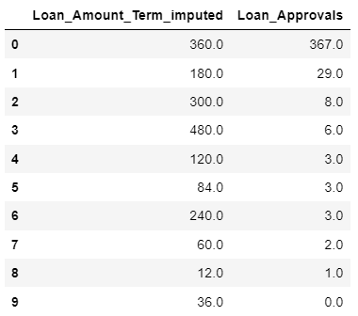
Q5. Which loan term is more likely to get approved?
The longer the term, the higher the approval rate. We can infer that a longer term would mean low EMI for the applicant making it safer.

Slide 16
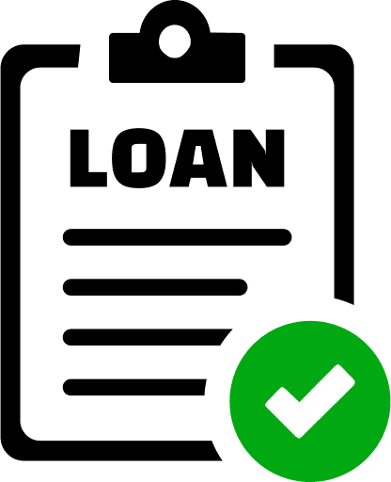
Optimal Risk Profile for Loan Approval
When creating a risk profile we can see that Graduated, Married applicants having less dependents, living in Semiurban property asking for the Loan for 360 months are more likely to get the Loan as they are in the low risk category

Slide 17
THANKS!

